Slide 1

Speech Emotion Recognition: Deep Learning Project
This presentation documents a deep learning project focused on speech emotion recognition, exploring its applications, methodology, and implementation.
OA

Slide 2
Project Overview
Project Goal
Team Members
Develop a system to accurately Detect and Classify Emotions from Human speech using deep learning techniques.
Abdallah Mohamed Abdallah Atta (Team Leader)
Mohamed Anwar Rashed
Sondos Saad Ali Bakeer
Omnia Asem Abd-Elgawad Sherif
Khloud Emad Mohamed Ghoniem
Monica Ibrahim Saeid Asaad

Slide 3

Project Benefits & Applications
Customer Service
Healthcare
Enhance interaction in call centers by identifying customer emotions.
Aid in diagnosing and monitoring mental health conditions.
Entertainment
Education
Improve user experience in gaming and virtual assistants.
Enhance e-learning platforms by adapting content based on student emotions.

Slide 4
System Architecture
Data Overview
1
Speech data in audio file formats (WAV, MP3, …) is the primary input.
2
Data Augmentation
Add Noise, Pitch Shift
Feature Extraction
3
Extracts acoustic features like MFCCs, chroma features, and spectrograms.
Data Preparation For Model
4
Encode Label, Split Data.
Model Training & Inference
5
Trains deep learning models on labeled datasets and applies them to classify emotions.
6
Emotion Detection
Outputs predicted emotion labels and confidence scores.

Slide 5
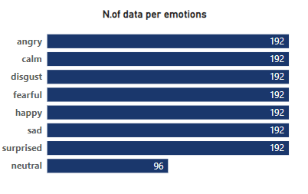
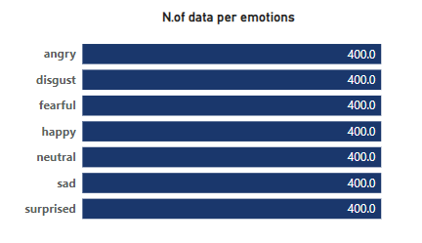
Dataset Overview
RAVDESS Dataset:
TESS Dataset:

Slide 6
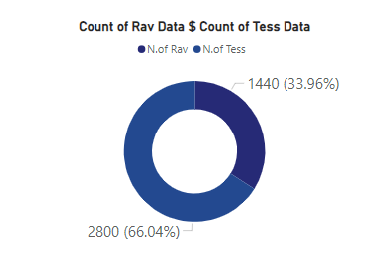
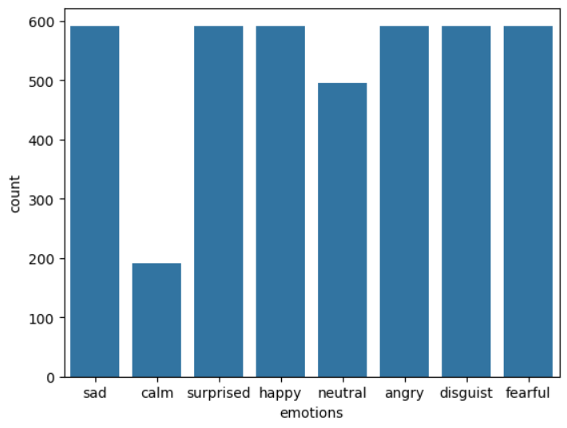
Dataset Overview
Data Distribution:
Emotions After Concatenation:

Slide 7

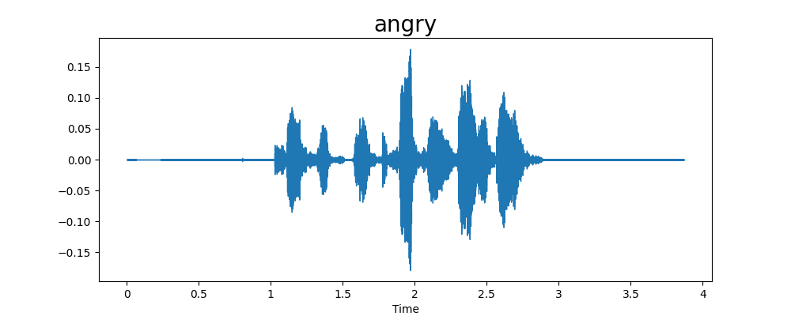
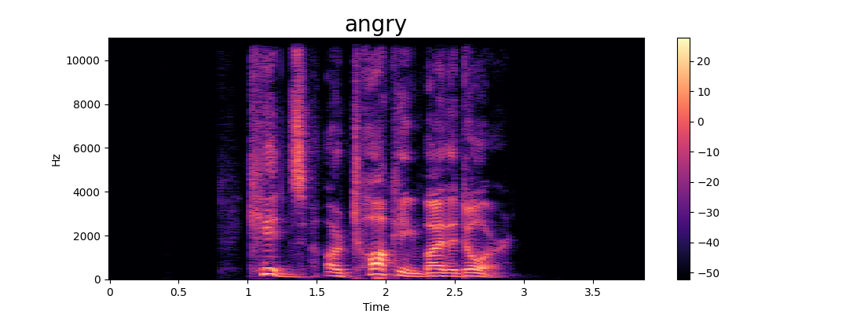
Data Exploration

Slide 8
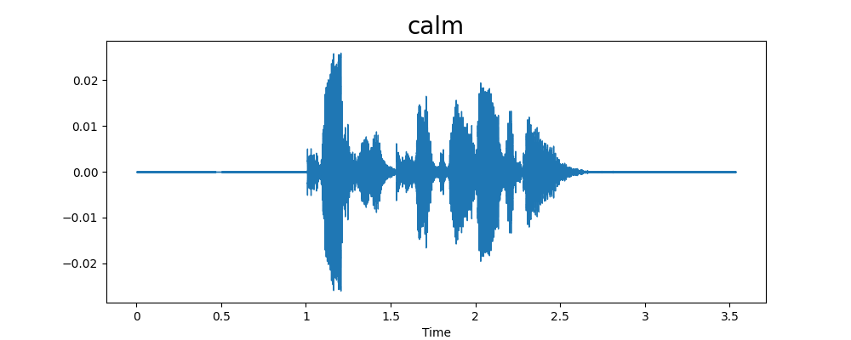
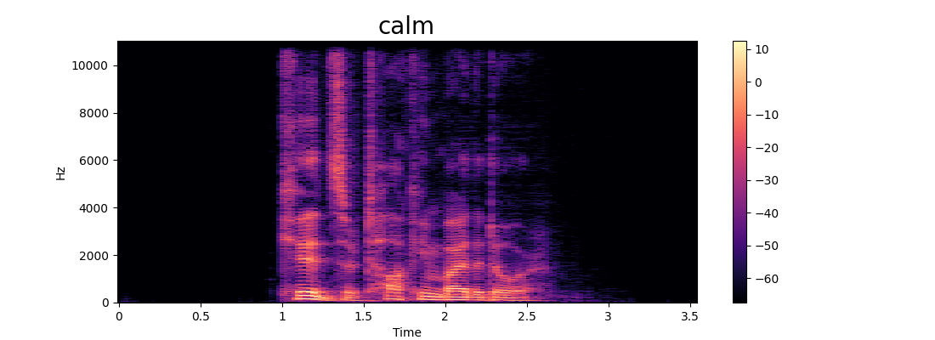
Data Exploration

Slide 9
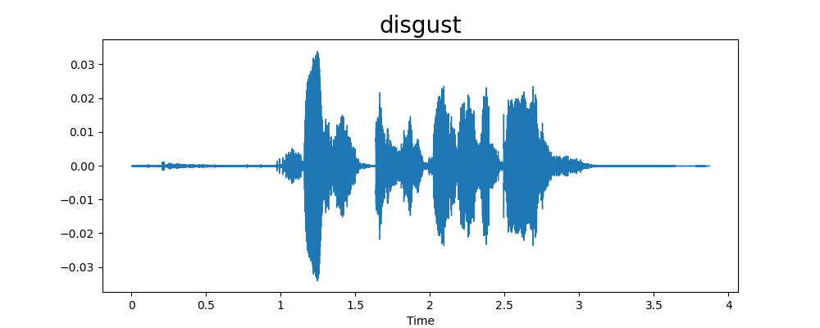
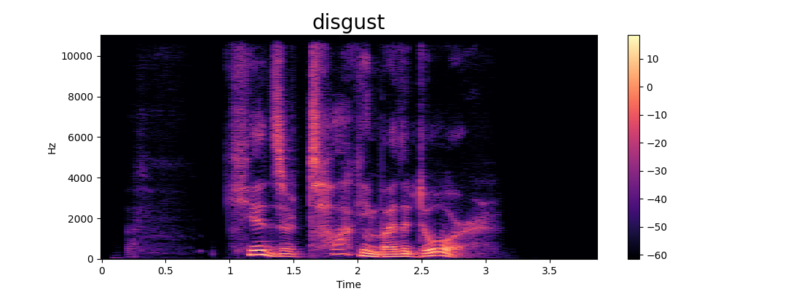
Data Exploration

Slide 10
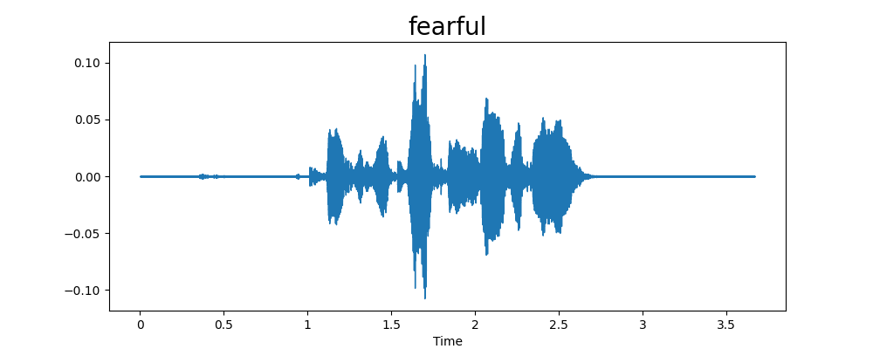
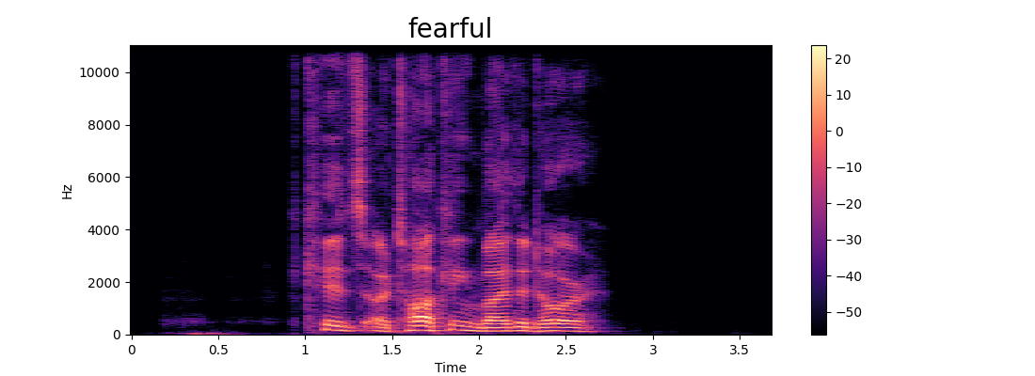
Data Exploration

Slide 11
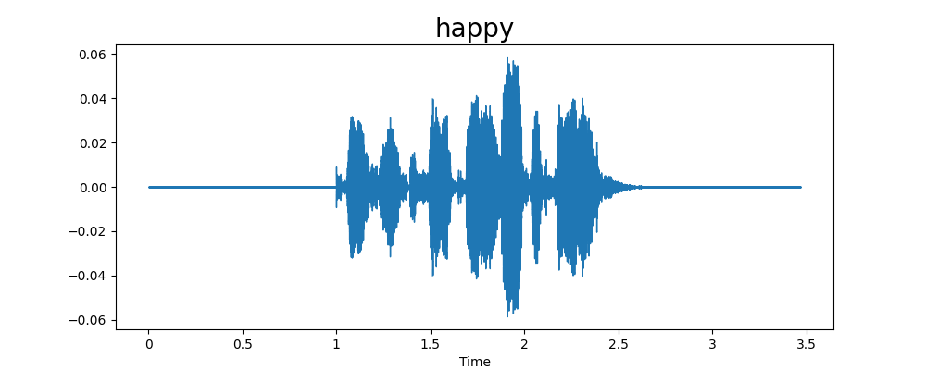
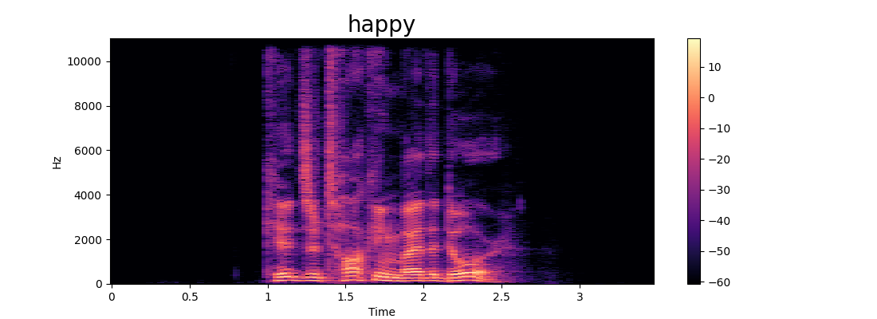
Data Exploration

Slide 12
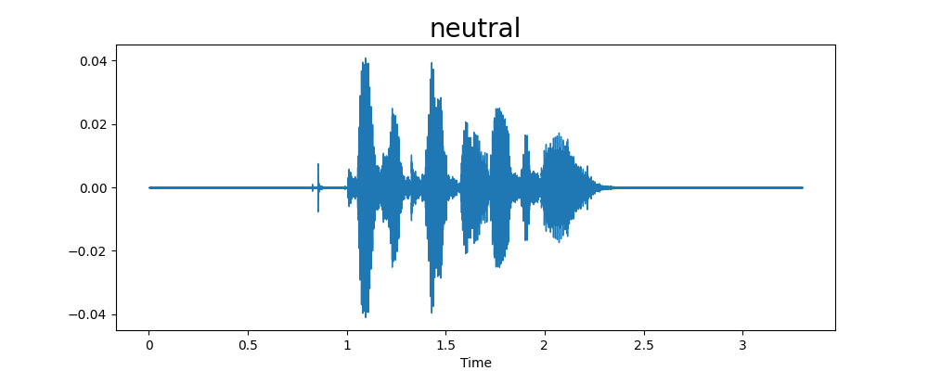
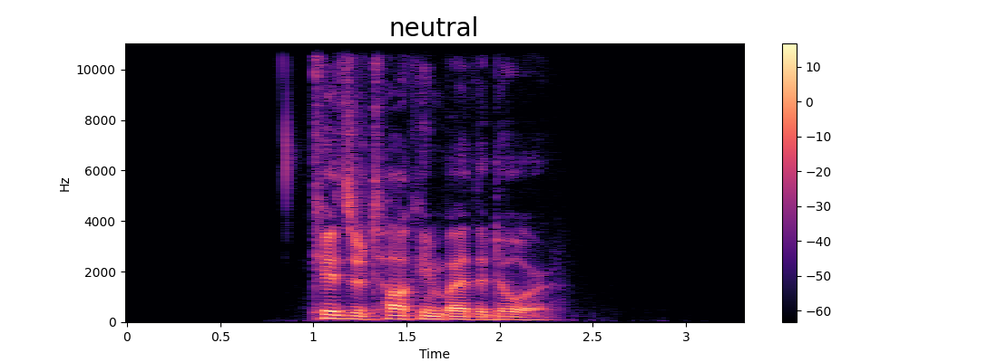
Data Exploration

Slide 13
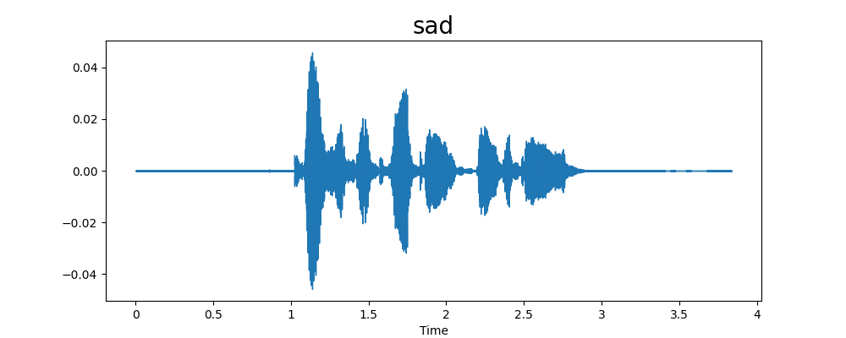
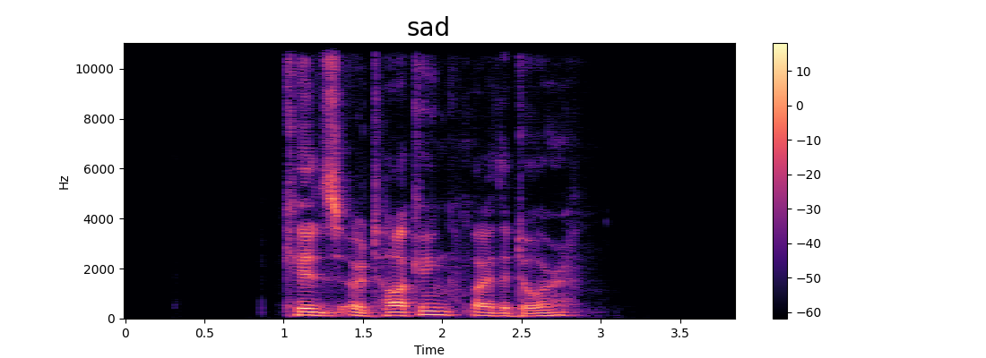
Data Exploration

Slide 14
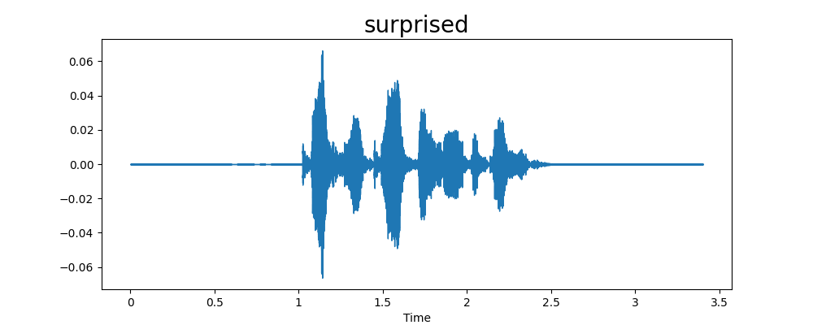
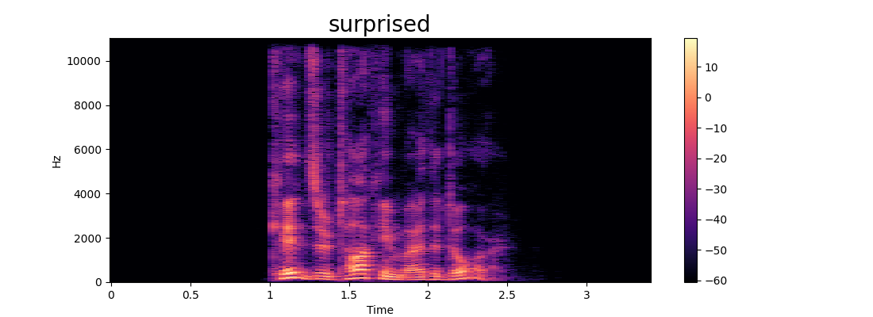
Data Exploration

Slide 15
Data Augmentation
Add Noise:
The method add_noise generates random noise and adds it to the original audio data, modifying the audio to simulate noisy conditions
Pitch Shift:
The method pitch_shift changes the pitch of the audio data, using a randomly chosen or predefined pitch factor.
Augment the Data:
Loop through each audio file in the emotion_data
For each file:
For 'neutral' emotion: Add noise until the count reaches the limit.
For 'calm' emotion: Add noise and also apply pitch shifting to augment the dataset.

Slide 16
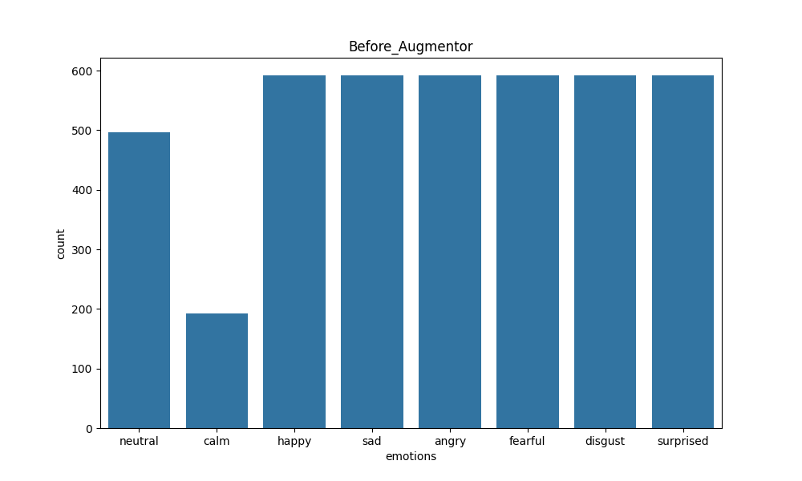
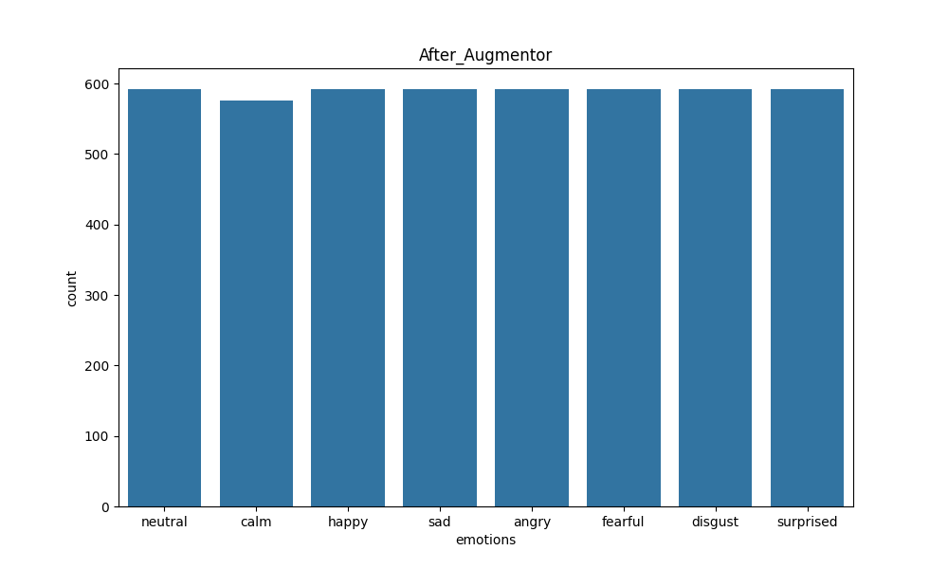
Before & After Augmentation

Slide 17
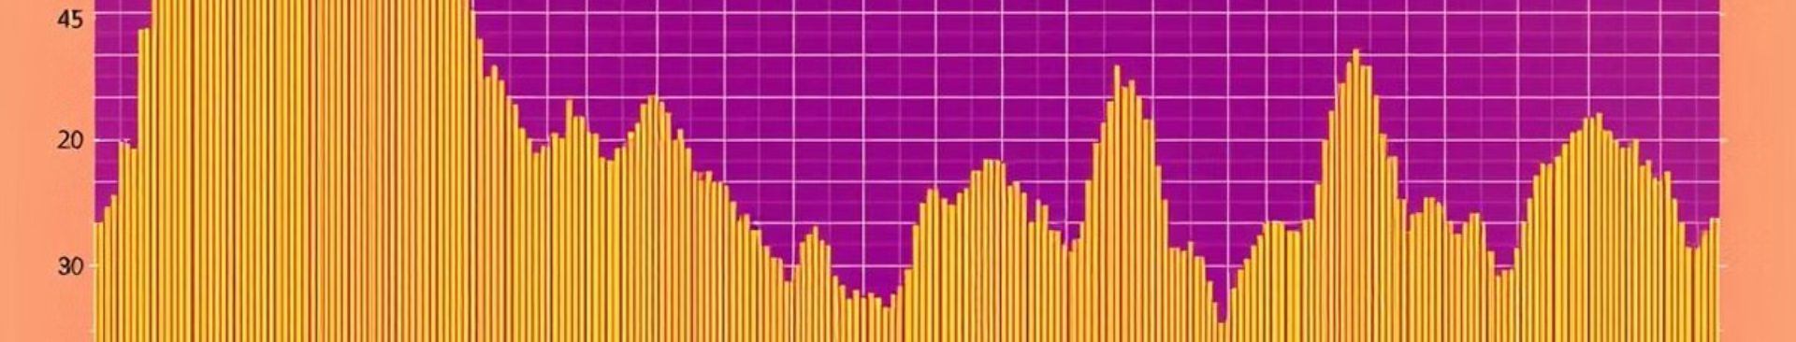
Feature Extraction Techniques
1
MFCCs
2
Spectrograms
Capture the short-term power spectrum of sound, mimicking human auditory perception.
Visual representations of frequency content over time, used as input to CNN models.
3
Chroma Features
4
Prosodic Features
Represent the energy distribution across 12 pitch classes, useful for detecting tonal characteristics.
Includes pitch, energy, duration, and intensity variations, helping detect emotional cues.

Slide 18
Data Preparation
The DataPreparator class encodes emotion labels using one-hot encoding with OneHotEncoder and saves the encoder for future use.
The class splits the provided features and encoded labels into training and test datasets using train_test_split.
The training and test sets are divided based on the specified test_size and random_state parameters.

Slide 19


Model Selection & Training
CNNs
Extract spatial features from spectrograms or log-Mel spectrograms.

Slide 20
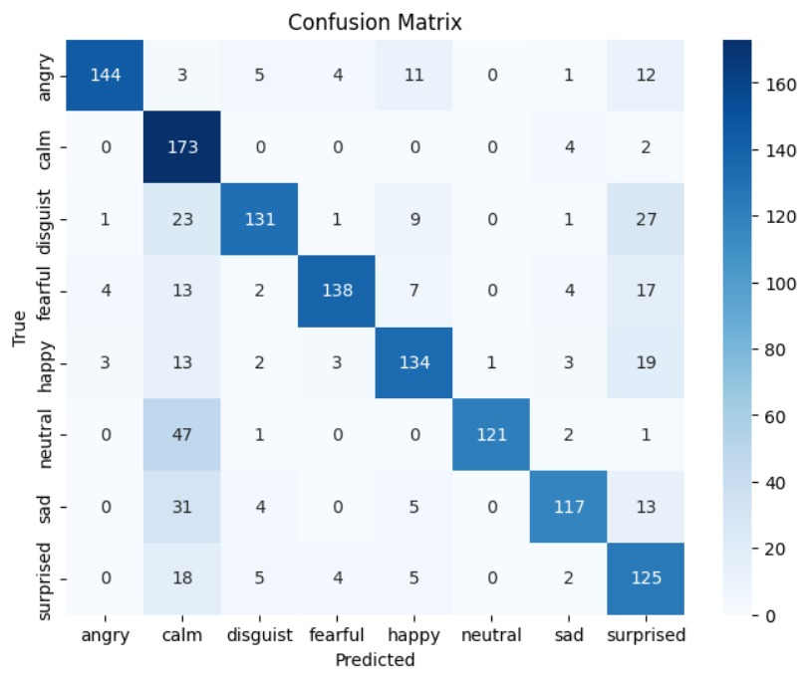
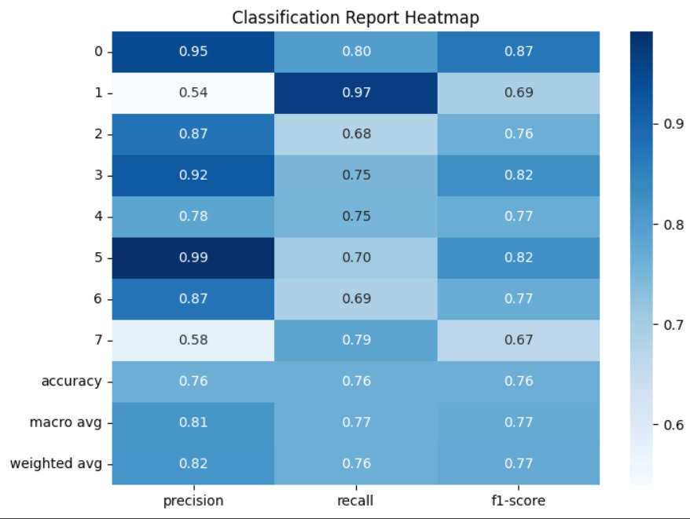
Confusion matrix and Performance matrix

Slide 21
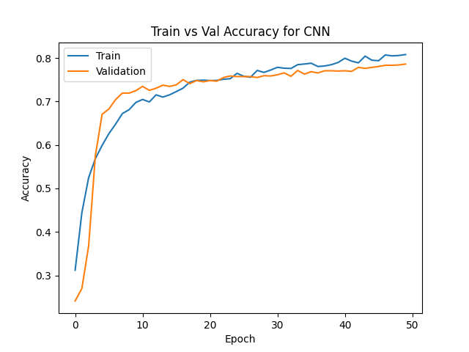
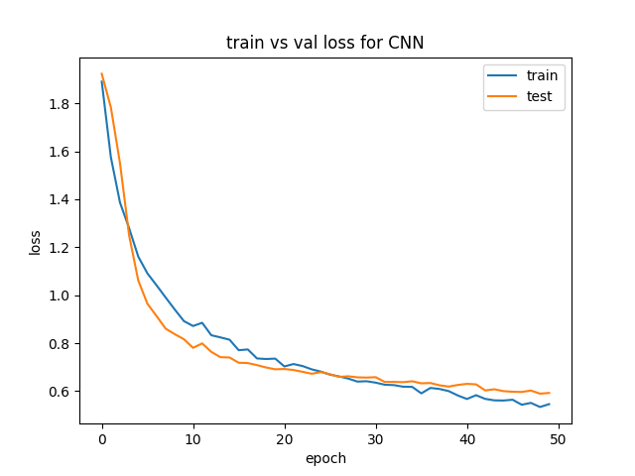
Accuracy And Loss

Slide 22

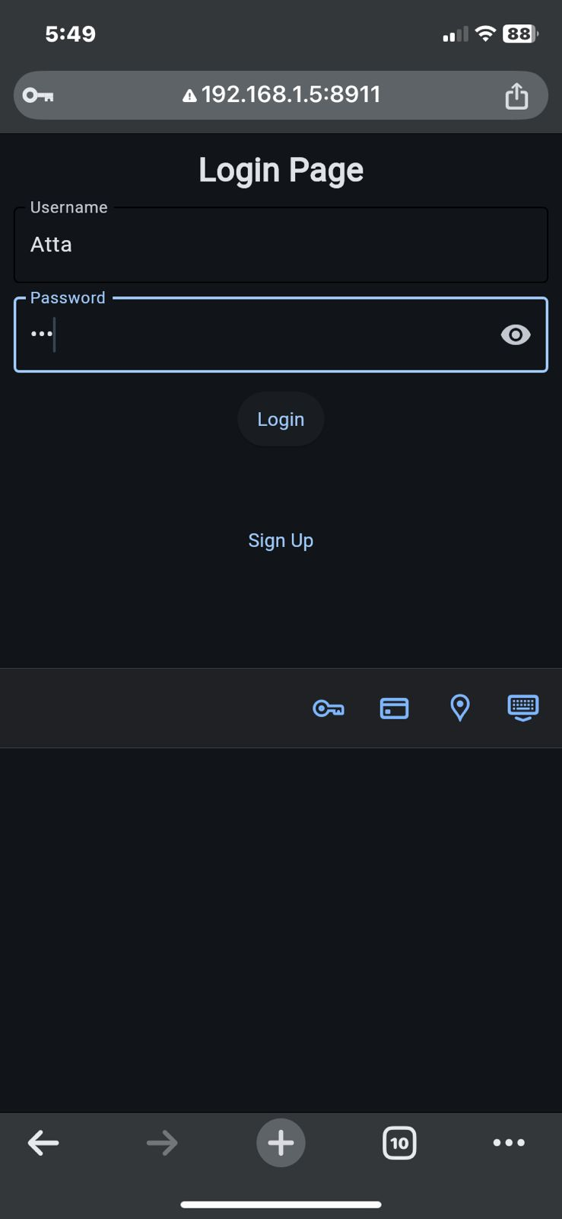
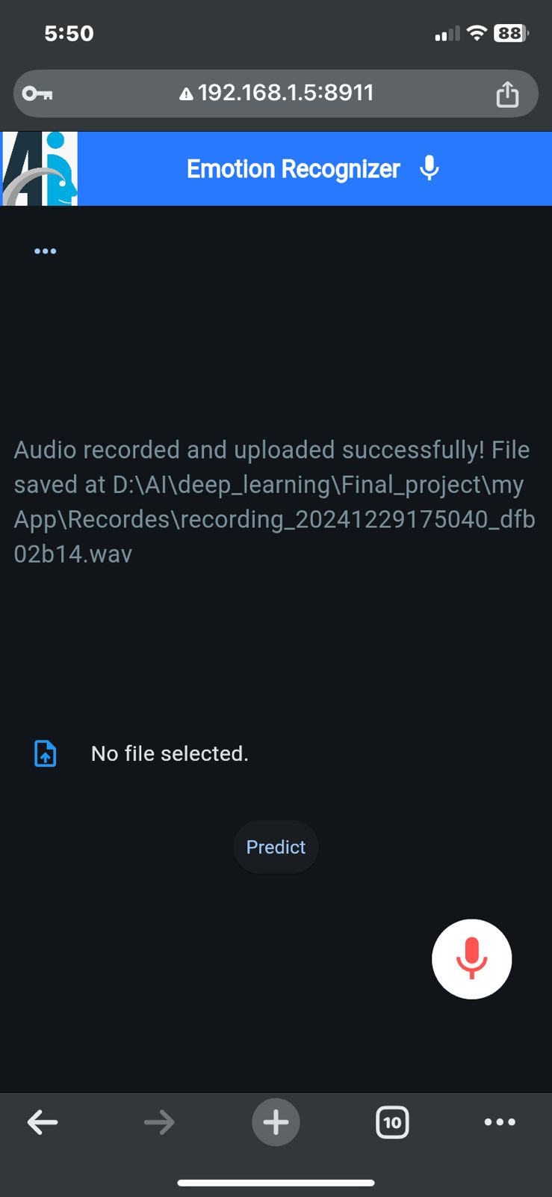
GUI Login
When Valid
When Login Valid

Slide 23

GUI Invalid Login
When Invalid username
password

Slide 24

GUI Signup
When Signup
After Back to Login

Slide 25
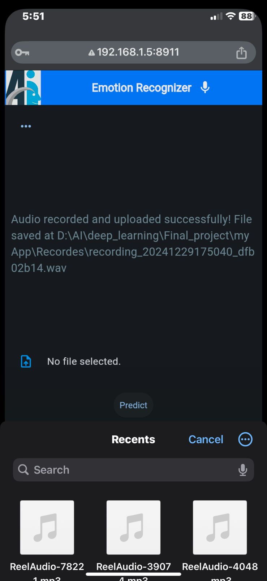
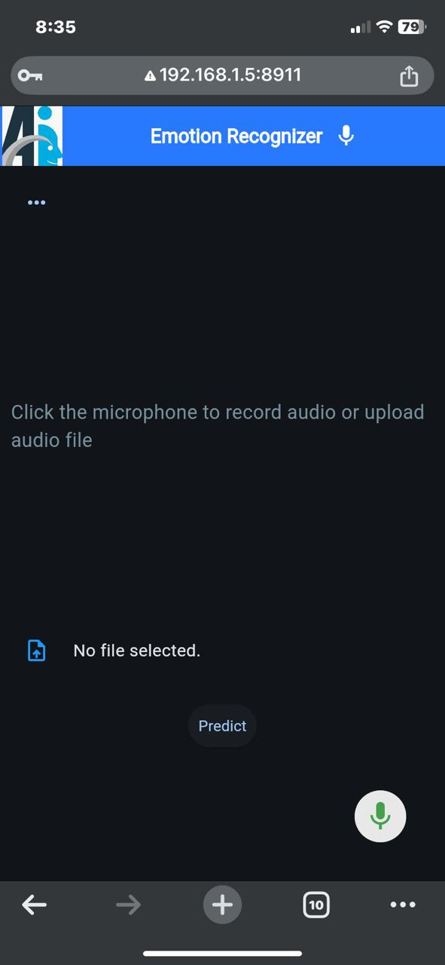
Audio GUI
Upload Audio
On Mic Click
On Mic Click
After Click

Slide 26
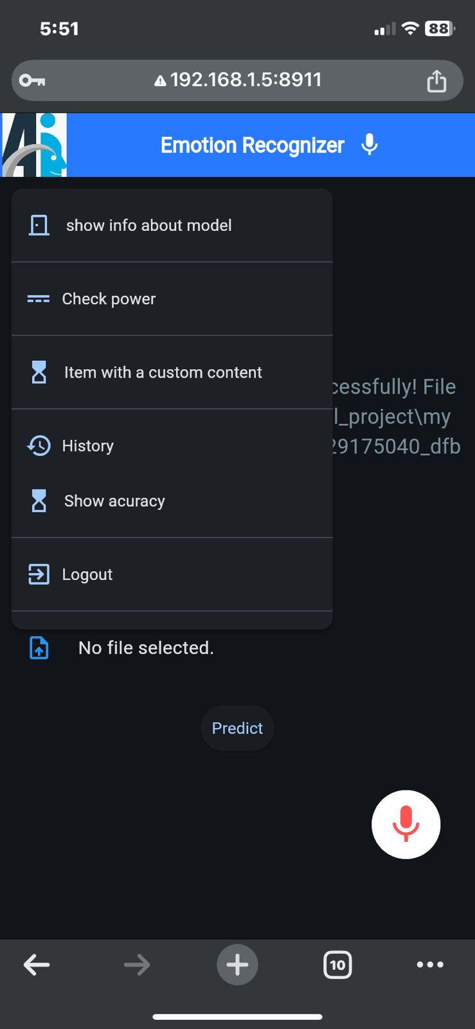
History GUI
Active bar
Records
History Records

Slide 27

Thank You!
We hope this presentation has provided valuable insights into our speech emotion recognition project.

